Slide 1
MONICA TEST PROGRAM PARAMETER CHECKING

Slide 2
How to check test parameters/configuration for MONICA BOM base test program
What you need before checking
1)CRD Document
2)Cross Table

Slide 3

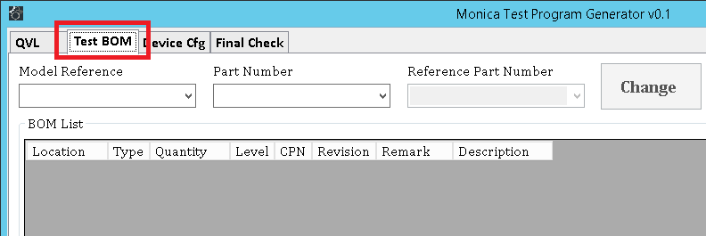
1)Execute “MonicaTPGenerator” on the desktop of the DDNS
2)Go to “Test BOM” tab

Slide 4
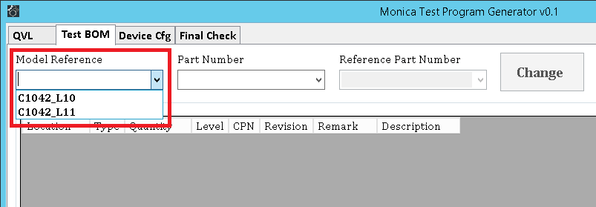
3)Select “Model Reference”
C1042_L10 (will be C1042.FULL.L10 in the future) for Mt. Stuart L10/L11 test
C1042_L11 (will be C1042.FULL.L11 in the future) for Mt. Stuart L11 PoT test

Slide 5
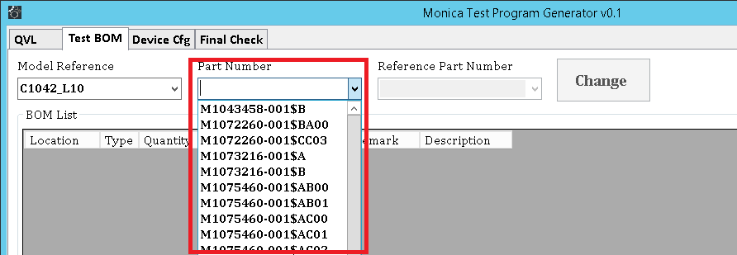
4)Select “Part Number”
If the Part Number that you would like to check does not exist in the list.
It means the test does not support yet, please contact TE to generate configuration for test!

Slide 6
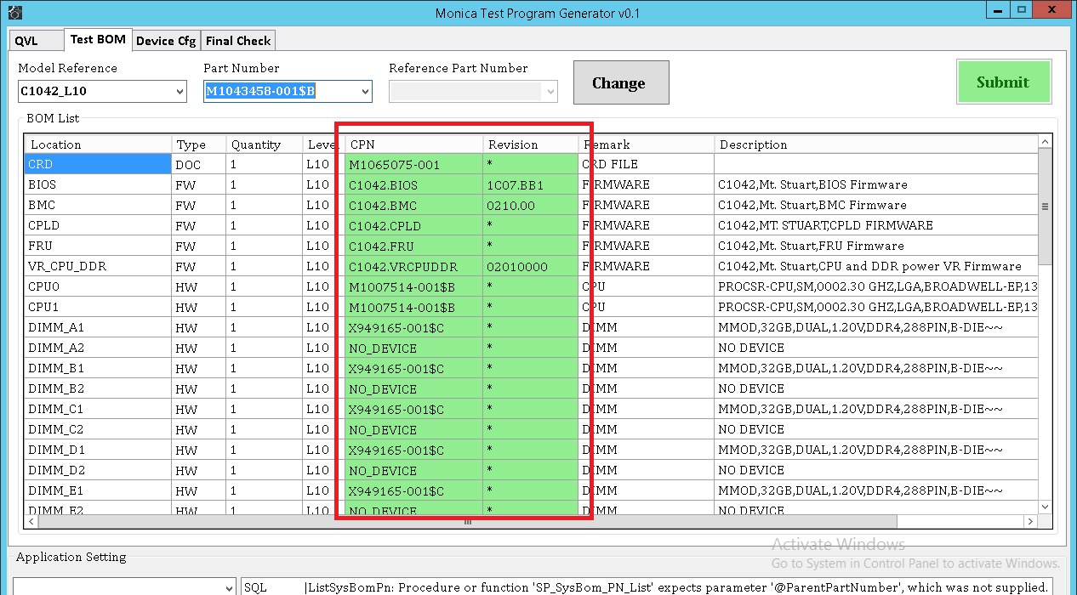
5)Check if Revision follow the CRD.
Check if CPN follow the cross table.
If not contact TE to submit a change for reviewing

Slide 7
6)Basically, the check items for Mt. Stuart would be
1)BIOS
2)BMC
3)FPGA1
4)MEZCN1
5)PCIe Slot #(2-4).R1.PCIEM1
6)PCIe Slot #(2-4).R1.PCIEM2
7)SATA 0-5
8)sSATA 0-3
9)TPM1

Slide 8
End

Slide 9
MONICA TEST PROGRAM CREATE BOM DATA

Slide 10
How to create test BOM data for MONICA BOM base test program
What you need before checking
1)SKU Document
2)CRD Document
3)Cross Table
4)OA access to PDM

Slide 11
R&R, Process of BOM data creation
WYHQ
SQL DB
Change Reviewing Reject/Approve
Review Data
Change
Re-Sync
5min
Device Cfg
Modify/New Add
TE Supervisor
Proxy
WYHQ MTE
Change Request
WYHQ STE
Submit
New/Change
Change Request
Device cfg
Modify/Add Request
Site TE
Site
SQL DB
Check
Site TT
Check
Issue/Problem found

Slide 12

Flow of BOM data creation
Create/Check
QVL
Create/Check
Test BOM
Create/Check
Device Cfg
To create BOM data,
1)QVL data is the first step to check/add new PN for the QVL of location.
Refer the SKU and cross table, then check if the device is allowed to be installed on the location.
2)After QVL checking, add new test BOM data for L10 or L11 based on SKU and CRD.
3)Then the final step is to add new device configuration if necessary.

Slide 13
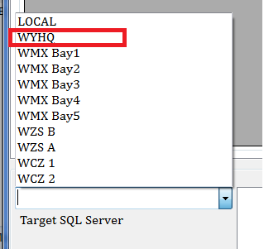
1)Execute “MonicaTPGenerator” on your OA computer,
you must in OA environment.
2)Set Target SQL Server to “WYHQ”

Slide 14
Model Reference
C1042_L10 | Wiwynn Mt. Stuart L10
C1042_L11 | Wiwynn Mt. Stuart L11 PoT
C2012_L10 | Wiwynn C2010 L10
C2012_L11 | Wiwynn C2010 L11 PoT
C202A_L10 | Quanta C2020 L10
C2032_L10 | Wiwynn C2030 L10
C206A_L10 | Quanta C2060 L10
C207A_L10 | Quanta C2070 L10
C2082_L10 | Wiwynn C2080 L10

Slide 15
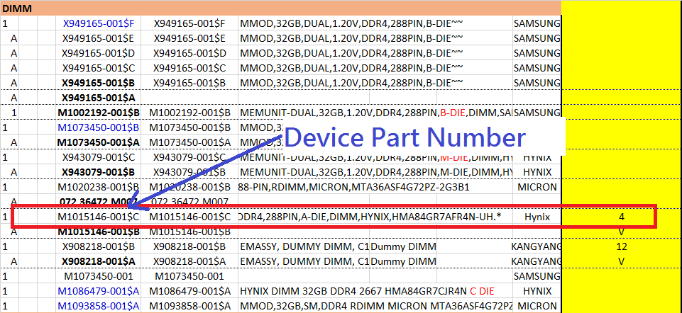
1)Create/Check QVL
CPU/Memory location mapping from SKU document
According to there is no location information in cross table (only the quantity), therefore you have to refer the SKU document for the physical location.
In the SKU document, it tells you about the location for the devices should be installed or not.

Slide 16
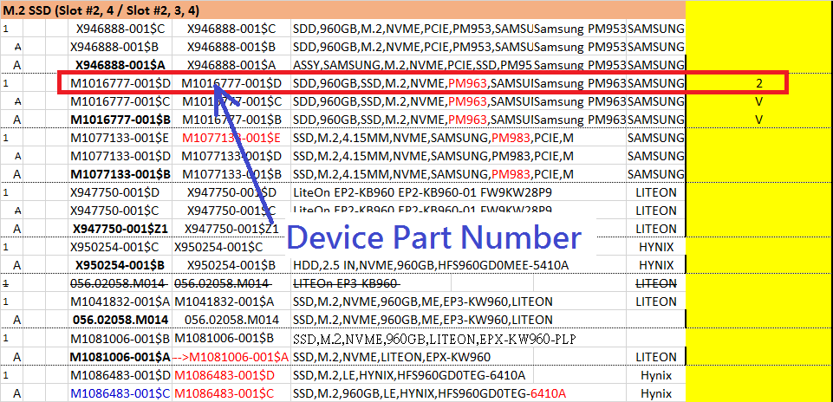
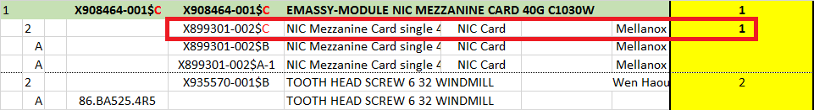
1)Create/Check QVL
PCIe location mapping from SKU document
M.2 devices are on the location of PCIe Slot#1-4. basically the PCIe Slot#1 has no M.2 to be installed, only the slot #2-4.
The FPGA is the device of L11.
But for C1042, it should be on L10 BOM list

Slide 17
1)Create/Check QVL
M.2/SSD/HDD location mapping from SKU document

Slide 18
1)Create/Check QVL
L11 Chassis location mapping from SKU document
Mt. Stuart | Logic Location Name | Physical Location Name
 | ToR | SWITCH1
 | PDU1 | PDU1
 | PDU2 | PDU2
 | UPS | UPS1
 | Load Balance | MPX1
 | miniPDU | MINIPDU1
CHx → Chassis #x

Slide 19
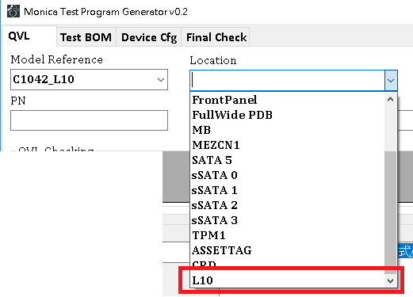
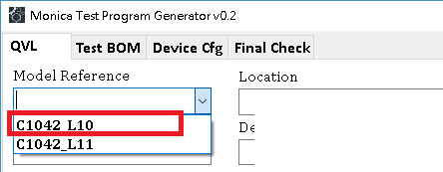
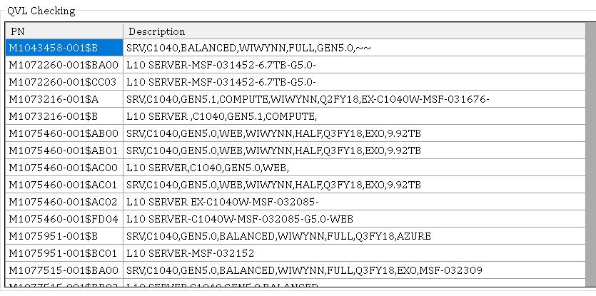
1)Create/Check QVL (L10)
Select Model Reference
i.e.
“C1042_L10” for Mt. Stuart L10 level BOM.
(see more detail modelref in previous page)
then select “L10” in location field.
In the QVL list,
Check if PN exist or not.
If PN exists then check device PN for all L10 location make sure device PNs are in QVL list, then go to Test BOM tab, if not you have to add new PN into L10 QVL.

Slide 20
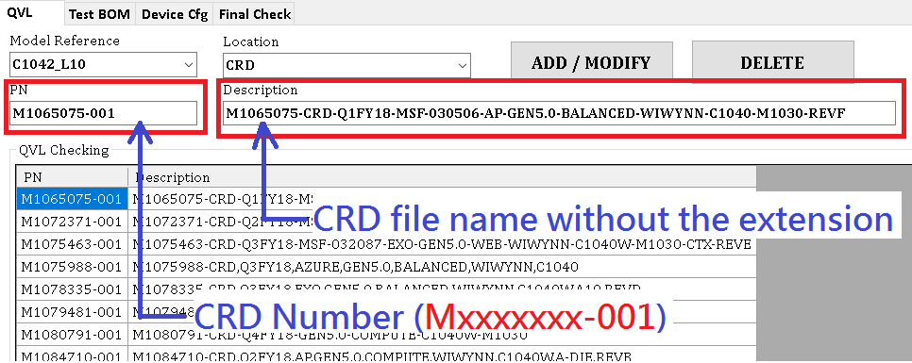
1)Create/Check QVL (L10)
For location “CRD”,
The PN is the number of CRD.
The description is the file name of the CRD without the extension.

Slide 21
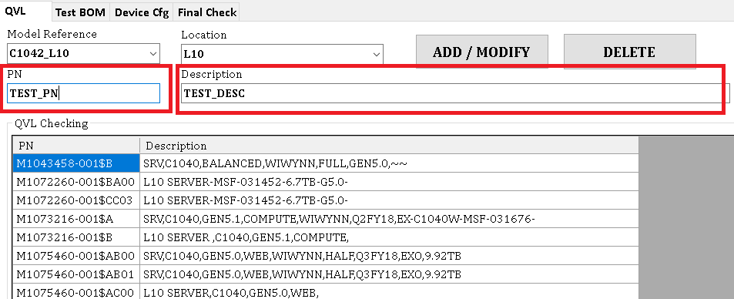
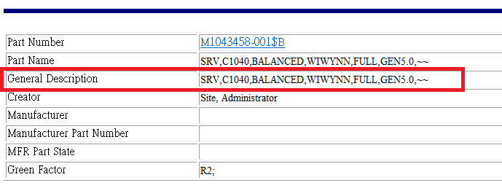
1)Create/Check QVL (L10)
Check all PNs in cross table for all locations in the list before go to test BOM tab.
Key-in new PN number on PN field, then go to http://wpqssvr.wistron.com.tw/wpqs_plm.htm to find the description of the PN, then copy “General Description” to Description field.
Then click “ADD/MODIFY” button to add new PN into L10 level QVL

Slide 22
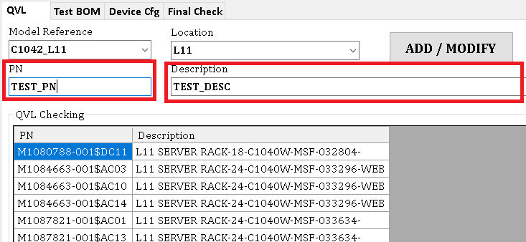
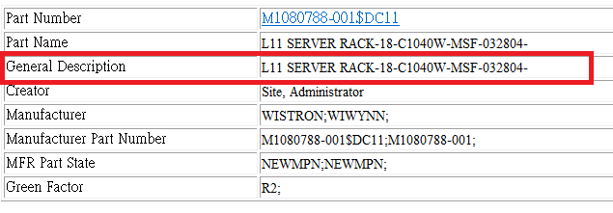
1)Create/Check QVL (L11)
Check all PNs in cross table for all locations in the list before go to test BOM tab.
Key-in new PN number on PN field, then go to http://wpqssvr.wistron.com.tw/wpqs_plm.htm to find the description of the PN, then copy “General Description” to Description field.
Then click “ADD/MODIFY” button to add new PN into L11 level QVL

Slide 23
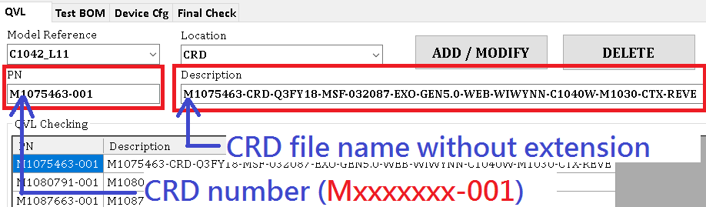
1)Create/Check QVL (L11)
For location “CRD”
The PN is the number of CRD.
The description is the file name of the CRD without the extension.

Slide 24
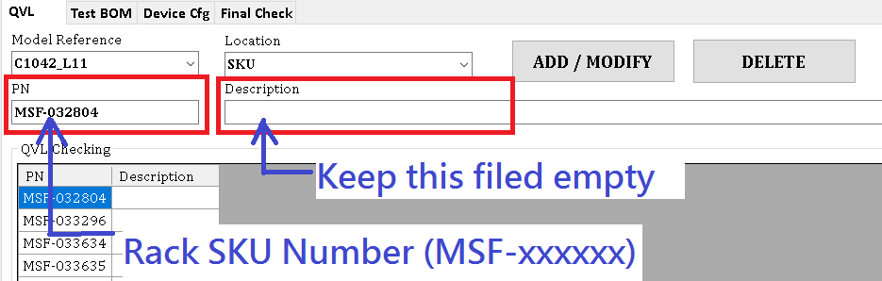
1)Create/Check QVL (L11)
For location “SKU”
The PN is the number of Rack SKU ().
Keep the description is “empty” of the SKU

Slide 25
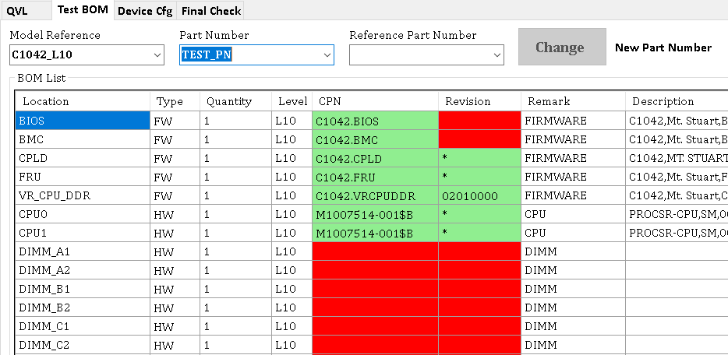
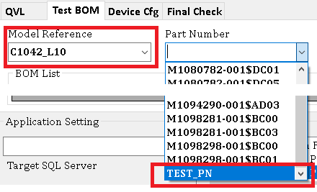
2)Create/Check Test BOM
When you choice the PN you would like to create, the BOM list would be a default list.
Choice the CPN and revision for all locations base on the CRD and cross table.
Make sure all data are set correctly before you submit the data.

Slide 26
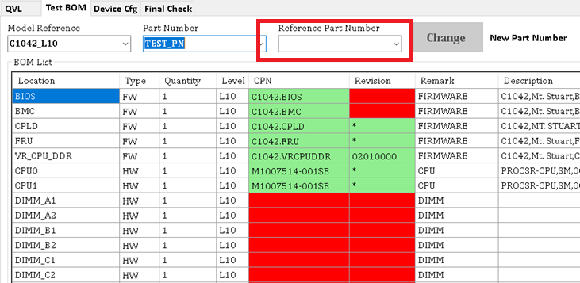
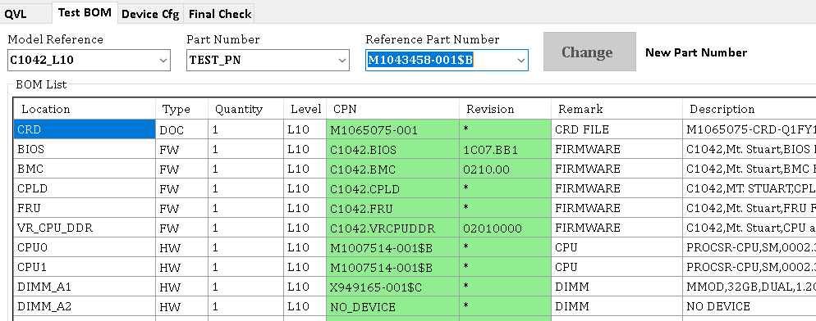
2)Create/Check Test BOM
If the primary PN (Mxxxxxxx-001) was created, and you just would like to create new sub-PN ($xxxx).
Or you would like to create new PN based on a known PN.
Then you can choice the “Reference Part Number”, it will reload new configuration table based on known PN.

Slide 27
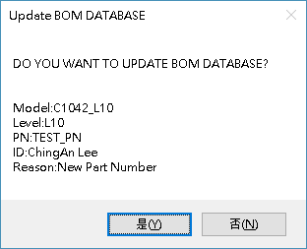
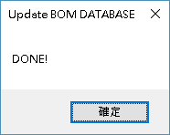

2)Create/Check Test BOM
If everything is OK, then click Submit button and follow the instruction to enter some information for reviewing.
1)The issuer’s name or Employee ID.
2)Click yes, to submit data to WYHQ DB
3)Make sure you see “Done“ message

Slide 28
3)Create/Check Device Cfg
For now, this is created by WYHQ not local TE for far.

Slide 29
End

Slide 30
MONICA TEST PROGRAM COLLECT WCS CONFIGURATION FILE

Slide 31
After BOM data approved by TE Supervisor or WYHQ MTE.
The databased will be synced within every 10min to WW sites.
Once data synced, you can run the test, then you need to collect WCS configuration file when 5x% (test wcs cfg) and 9x% (ship wcs cfg).

Slide 32
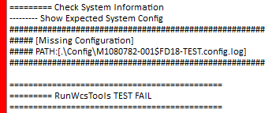
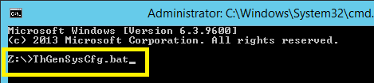
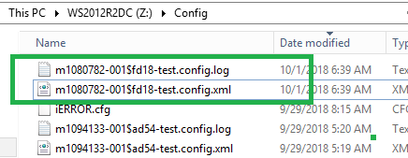
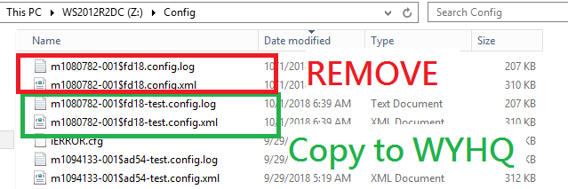
Pick up one good node which failed at 5x% “RUN WCS TEST TOOL”
Then login to blade.
1)Make sure the error message is “Missing Configuration”
2)Open command prompt then goes to driver Z:\
execute “ThGenSysCfg.bat”
3)Go to Z:\Config\ then delete “%PN%.config.log/xml”
4)Copy “%PN%-test.config.log/xml” to local

Slide 33
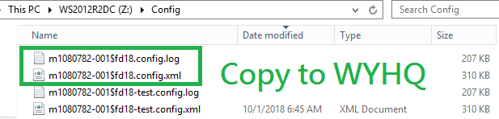
Pick up one good node which failed at 9x% “RUN WCS TEST TOOL”
Then login to blade.
1)Make sure the error message is “Missing Configuration”
2)Open command prompt then goes to driver Z:\
execute “ThGenSysCfg.bat”
3)Go to Z:\Config\ get the files
“%PN%.config.log” and “%PN%.config.xml”

Slide 34
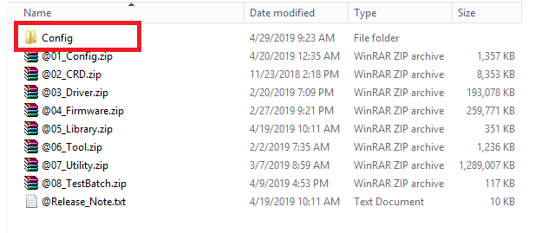
Copy latest WCS config. files to FS
1)Login to DDNS with Administrator account.
2)Go to driver Y:\XXXXXX_BomBase_L10,
the model you would like to update.
3)Copy the new WCS configuration file to “Config” folder
9)After test verified, upload WCS cfg to WYHQ FTP

Slide 35
Upload WCS config files to WYHQ FTP
FTP: wyhqo54000453-1.wistron.com.tw
Account: te
Password: p@ssw0rd
For L10 new WCS cfg file, upload here,
/01_TestProgram/Cxxxx-L10/@New/Config/
For L11 new cfg file, upload here,
/01_TestProgram/Cxxxx-L11-PoT/@New/Config/
Test program will be updated on Monday of every week

Slide 36
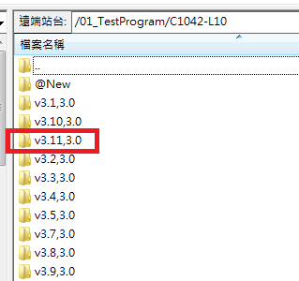
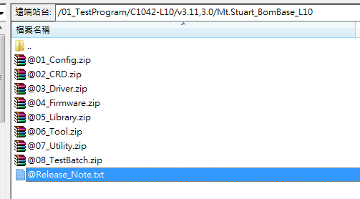
Download new BOM base test program
FTP: wyhqo54000453-1.wistron.com.tw
Account: te
Password: p@ssw0rd
Find the latest version and download to local
The copy updated file
You don’t have to download all the files, download the file with latest modification then upload to DDNS.
Always copy the file to Y:\ then move to the correct folder.
Test program will be updated on Monday of every week

Slide 37
End

Slide 38
MONICA TEST PROGRAM APPROVE BOM DATA

Slide 39
How to approve test BOM data for MONICA BOM base test program
What you need before checking
1)CRD Document
2)OA access to WYHQ DB

Slide 40
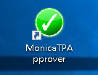
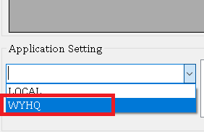
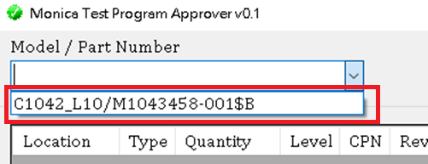
1)Execute “MonicaTPApprover” on your OA computer,
you must in OA environment.
2)Set Target SQL Server to “WYHQ”
3)Select the PN you would like to approve/reject

Slide 41
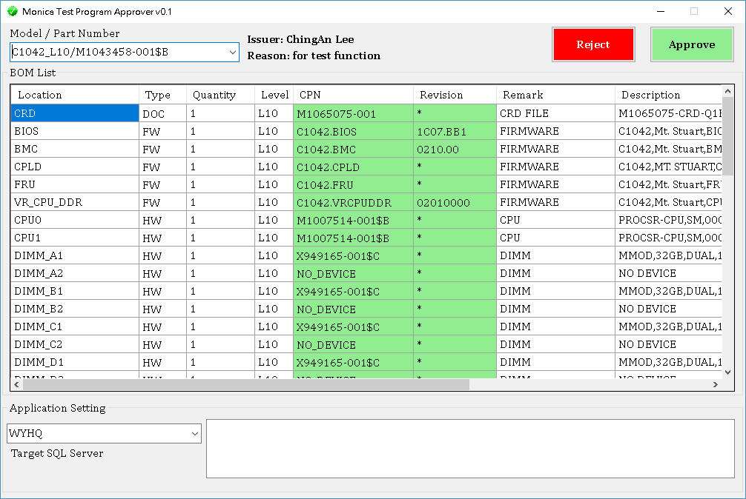
2)Approve/Reject Test BOM
Make sure if all settings match/follow the CRD/Cross table and SKU document.
Then Click Approve if there is no problem.
If not, Click Reject to drop the settings

Slide 42
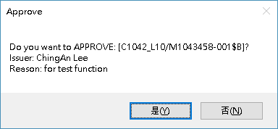

2)Approve/Reject Test BOM
Follow the instruction to enter some information to complete the DB updating.
1)The approver’s name or Employee ID.
2)Enter the reason/comment
3)Make sure you see “Done“ message

Slide 43
End

